Slide 1


Part I
Presentation by: Quincy Jacobs
Notes:
Part I will contain explanations for Examples 1 and 2 in the git repository.
https://github.com/QuincyJacobs/WebGLTutorial

Slide 2
The Tools
Getting all the tools necessary to get started with WebGL is surprisingly easy.
Check your browser’s compatibility: webglreport.com
2. Open your favorite text editor or IDE for JavaScript.
Now you’re good to go.
Notes:
You could download gl-matrix-min.js for easier calculations: glmatrix.net
I will not use it yet.

Slide 3
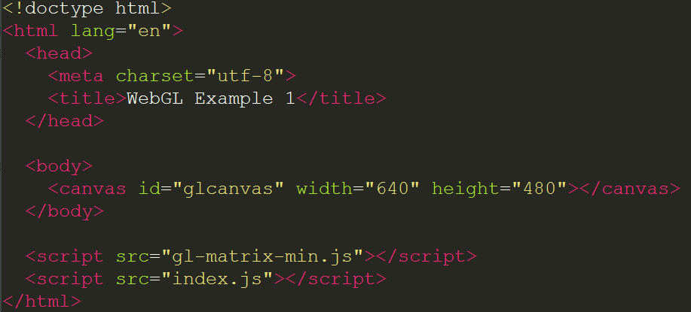
The HTML
Our actual WebGL code goes into index.js
Notes:
All we really need are the scripts and the canvas.

Slide 4
The CSS
Notes:
CSS is not necessary to make beautiful shapes when using WebGL with html5 canvas.

Slide 5
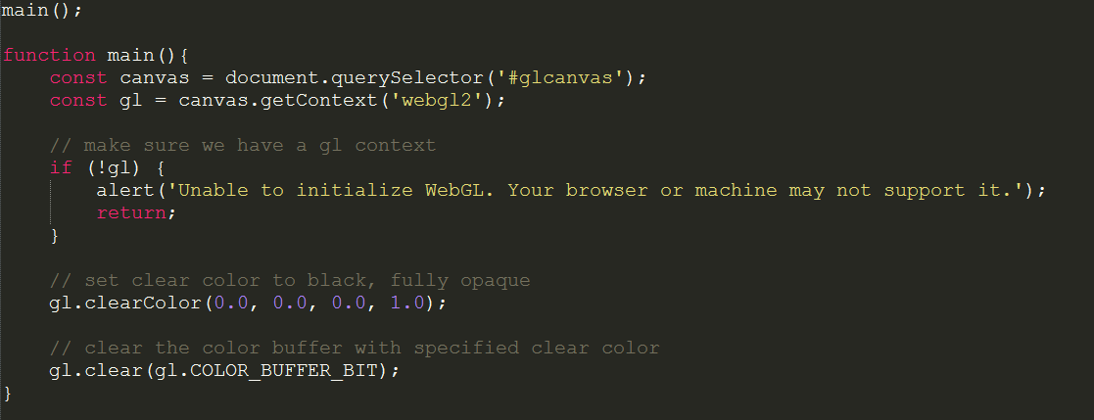
The First Step
Drawing a black background using WebGL
Notes:
The very first step is traditional javascript, we look for our canvas so we can draw to it later.
Next we want the WebGL context so we can start using the built-in WebGL functionality in your browser.
I also added a step that alerts when a WebGL context has not been found, but this is optional.
Next we set a clearColor. WebGL will cideally clear the screen every frame. With the last 2 instructions we specify what this color will be, and then actually make WebGL clear the screen.
Note the clearing of the screen is done only once, we have no interaction or updates at all. We will be talking about a drawing loop in a later slide.

Slide 6
The First Step
You can download/clone the code from my Github:
https://github.com/QuincyJacobs/WebGLTutorial

Slide 7
Graphics pipeline
= Adjustable steps (Shaders)
= Automatic steps
Vertex Shader
Shape Assembly
Geometry Shader
Rasterization
Fragment Shader
Tests and Blending

Slide 8
Steps for drawing a triangle
We will need all of the following WebGL objects to draw a triangle:
Vertex array buffer
Element array buffer
Vertex shader
Fragment shader
Shader program

Slide 9
Steps for drawing a triangle
These necessary elements are created and used in the following steps:
Array Buffer Objects
Shaders and Shader Program
Linking Buffers and Shaders
Drawing

Slide 10
Step 1: Array Buffer Objects

Slide 11
Array Buffer Objects
A Vertex Buffer contains information about each vertice, which shaders will use for calculations and translations.
Our vertex buffer will only contain 3d positions for each vertice:
Vertice 1
Vertice 2
Vertice 3
VERTEX BUFFER
Position x
Position y
Position z
Position x
Position y
Position z
Position x
Position y
Position z
…
Notes:
We will start with our vertex buffer. First we need to understand what a vertex buffer is, so we can fill it with usable data. A Vertex Buffer contains information about each vertice which shaders will use for calculations and translations. (more on shaders later)

Slide 12
Array Buffer Objects
How does WebGL interpret the view?
Y: 1
X: -1
X: 1
Y: -1
Notes:
To find out what kind of positions we put into our buffer, we first need to find out how WebGL sees the view, and how our input data will translate to that.

Slide 13
Array Buffer Objects
What will our triangle look like?
Y: 1
X: -1
X: 1
Y: -1
Notes:
We first need to visualize what we wish to accomplish.

Slide 14
Array Buffer Objects
What data do we need?
Y: 1
X: 0.0
Y: 0.5
Z: 0.0
X: -1
X: 1
X: -0.5
Y: -0.5
Z: 0.0
X: 0.5
Y: -0.5
Z: 0.0
Y: -1
Notes:
Now we decide our type and ascertain the points we need as vertices. The usual type for positions are floats, so we will use floats as well

Slide 15
Array Buffer Objects
The result:
Let’s format this mess…

Slide 16
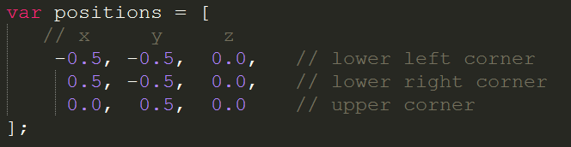
Array Buffer Objects
The result:
Better!

Slide 17
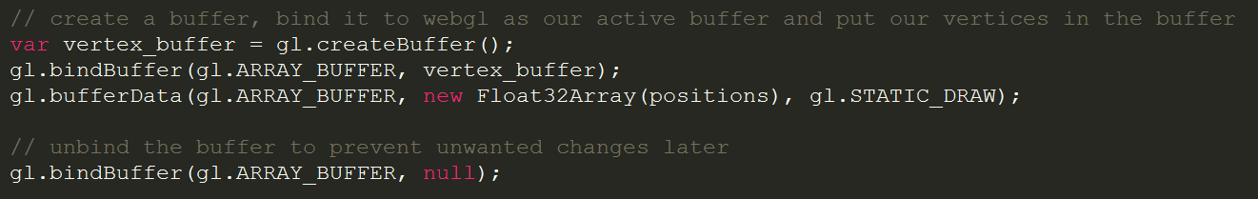
Array Buffer Objects
Now let’s prepare our buffer so WebGL can eventually send it to the shaders.
Notes:
bufferData arguments:
Type of buffer
Bufferdata (32 bit float array of positions in our case)
Type of drawing (STATIC_DRAW indicates to WebGL that the vertex data will not move at all, so WebGL can optimize. There are more options, but for frequently changing parts use gl.DYNAMIC_DRAW

Slide 18
Array Buffer Objects
Next we will need a buffer that holds the indices that form a triangle.
Y: 1
2
0 ->
1 ->
2 ->
X: -1
X: 1
0
1
Y: -1
Notes:
The indices seem like double work right now, but will come in handy when defining more triangles in the same vertex buffer. It eliminates the need for a lot of positions that would otherwise be defined twice.

Slide 19
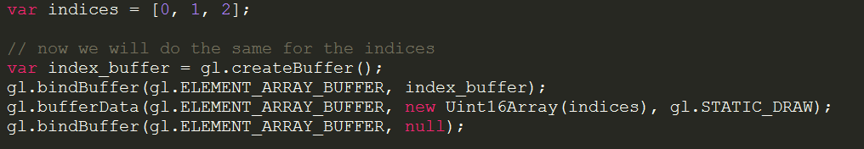
Array Buffer Objects
The Indices will be saved as an Element Array Buffer. The way to do this is similar to the (Vertex) Array Buffer

Slide 20
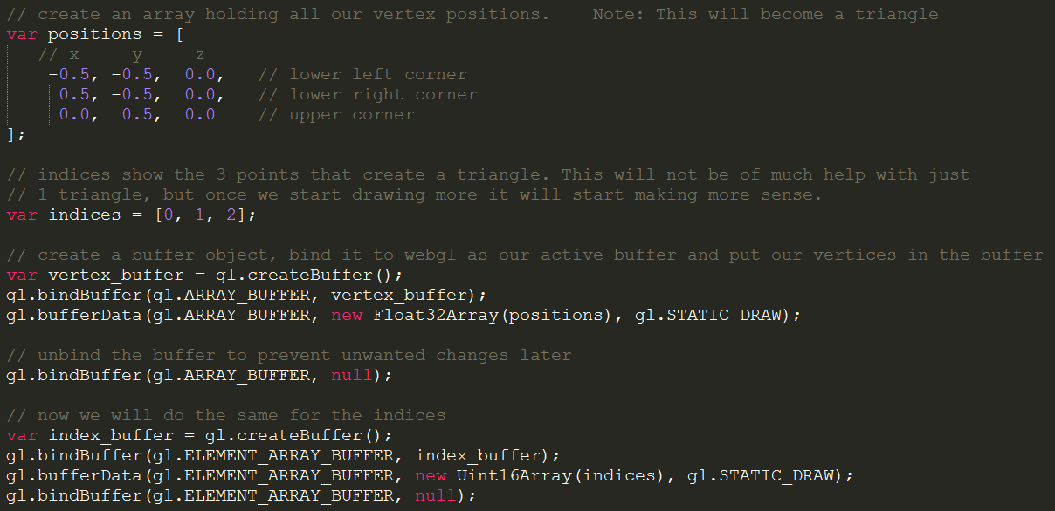
Array Buffer Objects Results
Notes:
This is the resulting code.

Slide 21
Step 2: Shaders and Shader Program

Slide 22
Shaders and Shader Program
As we recall from the graphics pipeline slide, we can supply code for 3 Shaders:
Vertex Shader
Geometry Shader
Fragment Shader
We will only create a Vertex Shader and a Fragment Shader. The Geometry Shader is not necessary.

Slide 23
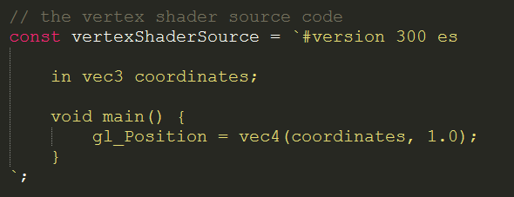
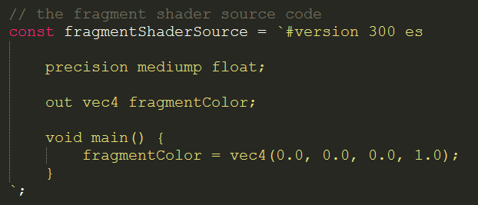
Shaders and Shader Program
Shaders are written in their own language called GLSL (OpenGL Shader Language)
Our Shader code will be defined as a constant string.
Vertex Shader
Fragment Shader
Notes:
The attribute in the Vertex Shader will be the point where we inject our own (vertex) position buffer. From there on WebGL will handle the rest of the pipeline, so the output of the Vertex Shader will be the input of the next step in the Pipeline and so on.
gl_position and gl_fragcolor are standard keywords in GLSL where the Shader will expect a value to supply to the next step in the graphics pipeline.

Slide 24


Shaders and Shader Program
In the next step we create Shader Objects, attach the source code, and compile the source code.
Vertex Shader
Fragment Shader
Notes:
The creation of Shader Objects looks a lot like the creation of Vertex Buffer Objects.
The first call is to register the object and get an ID pointing to the object.
The next call connects the Shader object to the shader source.
The last call compiles the shader source into the object.

Slide 25
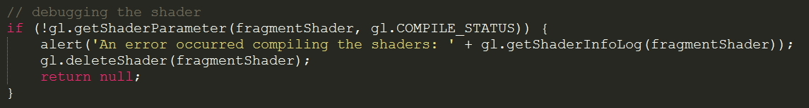
Shaders and Shader Program
These lines will check if the shader compiled and give an error if it was not compiled.

Slide 26
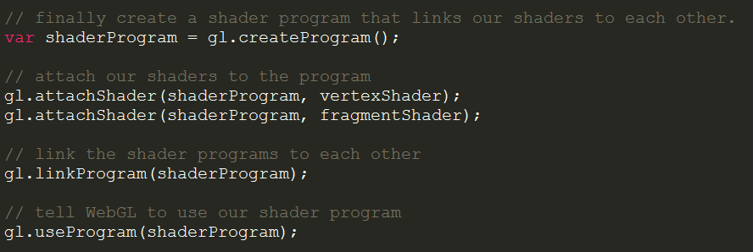
Shaders and Shader Program
Now we connect the shaders in a program and tell WebGL to use the program.
Notes:
First we create a program object (much the same as the Vertex Buffer Object and the Shader Objects)
Then we attach both shaders.
Next we link the shader together into the final program.
Finally we tell WebGL to use our program.

Slide 27
Step 3: Linking Buffers and Shaders

Slide 28
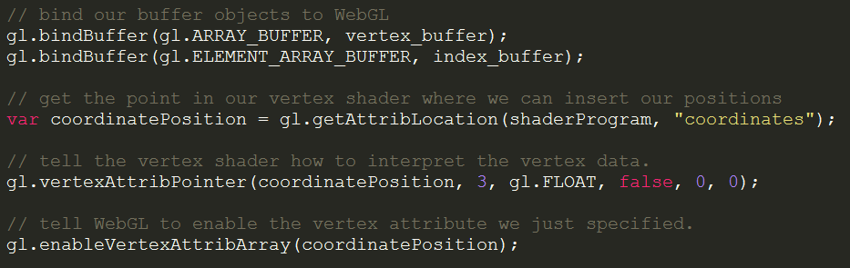
Linking Buffers and Shaders
This is all the code necessary to link the buffers and shaders.
Notes:
The first two lines are lines seen before. We tell WebGL to bind our Vexrtex Buffers again, as we will not modify anything that could change them anymore. The next 2 lines are harder and will be explained in the next slide.
The last line just tells WebGL to enable whatever we told it to interpret and into which object.

Slide 29
Linking Buffers and Shaders
These 2 lines tell WebGL where to insert our Buffers into the shaders and how to interpret the Buffers.
Notes:
The first call makes WebGL look for the “coordinates” variable in the shaderProgram. We defined an input in our vertex shader called coordinates which we will now use to input our shader data.
Next we tell WebGL how to input our Vertex Array into this input per point. This is 3 positions (3d vector), as FLOAT types, with 0 bytes in between those 3 Floats per point, and no additional data to skip in front of the array.

Slide 30
Step 4: Drawing

Slide 31
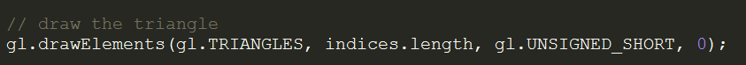
Drawing
This line tells WebGL to start drawing triangles.
Notes:
First we tell WebGL to interpret our positions as triangles.
Then we tell WebGL we have (indices.length) amount of positions to insert.
Next is the Type which our Element Buffer Object contains.
Lastly is the offset. (This is to ignore a certain amount of bytes at the start of the array if we have additional information at the start of the array.)

Slide 32
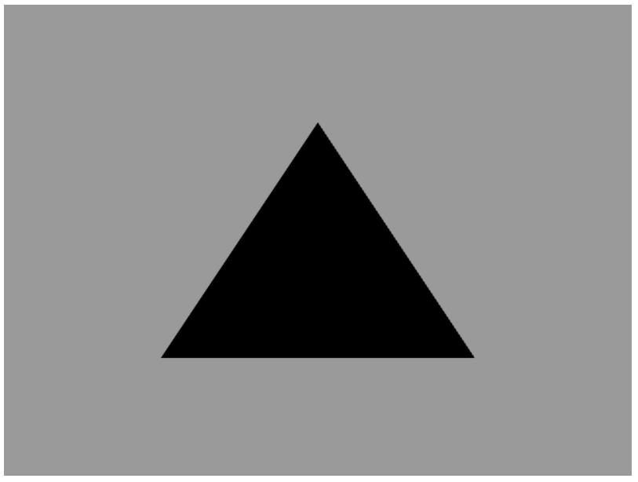
The result

Slide 33
Afsluiting
Thanks for listening.

Slide 35
Part II
Presentation by: Quincy Jacobs
Notes:
Part II will contain explanations for Examples 3 in the git repository and make a start with vector math .
https://github.com/QuincyJacobs/WebGLTutorial

Slide 36
Session preview
This session will focus on these points:
Colors array and (color) Vertex Buffer Object
Combining the Color and Position Vertex Buffers
Transformations and the math behind them
Part 1: 2D vectors

Slide 37
Step 1: Colors array and
(color) Vertex Buffer Object

Slide 38
Colors array and (color) Vertex Buffer Object
Similar to the position vertex array the color vertex array will have 3 elements: r, g, b.
Vertice 1
Vertice 2
Vertice 3
VERTEX BUFFER
R
G
B
R
G
B
R
G
B
…
How does WebGL interpret color data?
Notes:
If you remember the position Vertex Array from the previous presentation, you’re in luck. The color Vertex Array will be almost the same as it also contains 3 objects per vertice. Instead of x, y, z this will become r, g, b. We leave out the alpha channel for simplicities sake.

Slide 39
Colors array and (color) Vertex Buffer Object
WebGL takes in positive floats as RGBA color values between 0 and 1
R
0.0 … 1.0
G
0.0 … 1.0
B
0.0 … 1.0
What will the raw data look like in code?
Notes:
The data will be given as float. It is our choice to hand it as float our a binary value, but for simplicity let’s pick float again. The values offered can only be positive. If any value is given that is not from 0.0 to 1.0, the vertex will be black.

Slide 40
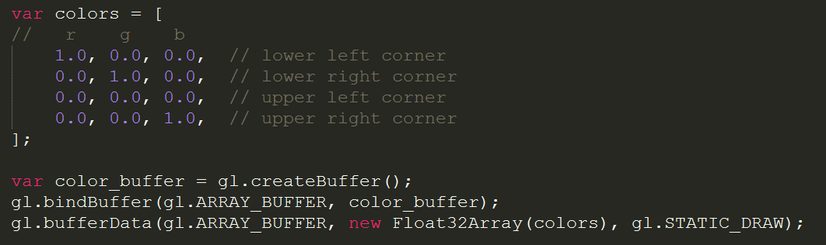
Colors array and (color) Vertex Buffer Object
The array closely resembles the position array, and even the creation of the object is the same.
Where do we insert our colors in the shader?
Notes:
The array is exactly the same as the positions array. The colors have the same amount of vertices (4). The array buffer is also almost the same as the position array buffer.

Slide 41
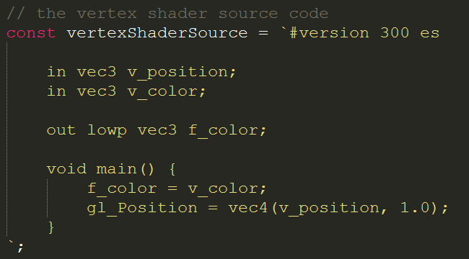
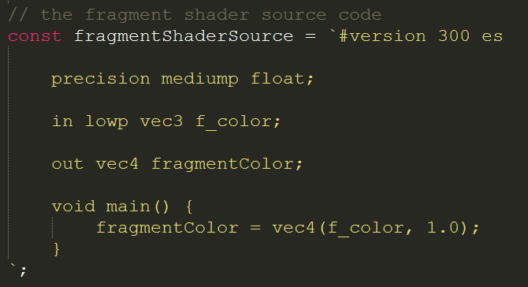
Colors array and (color) Vertex Buffer Object
We have to specify a new input variable in the Vertex Shader, and give it to the Fragment Shader
Next we will tie everything together in the code
Notes:
Compare the shader code to the cade of the previous presentation. You can clearly see a new ‘in’ variable being specified in both, and also the vertex shader has an out f_color. For convenience I have called all vertex shader variables v_name and fragment shader variables f_name.

Slide 42
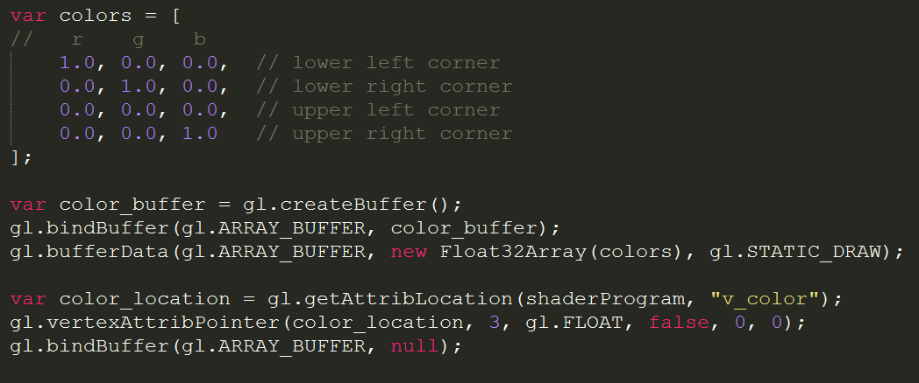
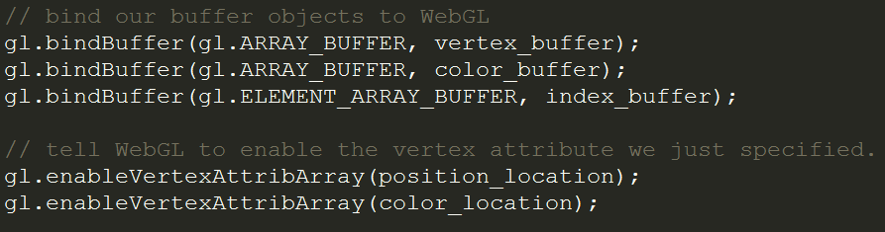
Colors array and (color) Vertex Buffer Object
Next we will tie everything together in the code
Notes:
With these lines we have established a way to get colors onto each vertice. Now let’s improve this so we can fit our colors and positions into a single buffer!

Slide 43
Step 2: Combining the Color and
Position Vertex Buffers

Slide 44
Combining the Color and Position Vertex Buffers
Vertice 1
Vertice 2
Vertice 3
POSITION BUFFER
Position x
Position y
Position z
Position x
Position y
Position z
Position x
Position y
Position z
…
Vertice 1
Vertice 2
Vertice 3
COLOR BUFFER
R
G
B
R
G
B
R
G
B
…
How should we combine these 2 arrays?
Notes:
These are the position and color buffers we created earlier. We have to combine them in some way that would be convenient for WebGL. Luckily WebGL support a certain way to read data from the array in an orderly fashion, but we’ll come to the reading in part later.

Slide 45
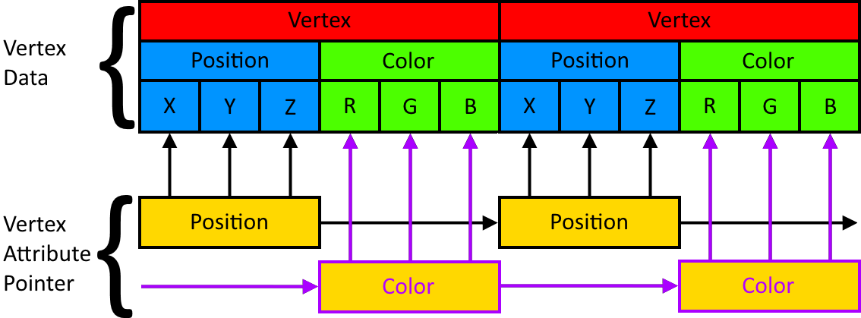
Combining the Color and Position Vertex Buffers
We simply place the position and color of each vertex right behind each other
How would WebGL filter these out and give them to the right in variable in the vertex shader?
Notes:
The answer is to simply declare each vertex after each other. Each vertex has 6 floats now, and the position and color come right behind each other for each vertex.

Slide 46
Combining the Color and Position Vertex Buffers
We use 2 vertex attribute pointers, one for positions and one for colors. Now let’s see the code.
Notes:
The positions and colors vertex attribute pointers cycle in getting 3 floats, then skipping 3. The color vertex attribute skips 3 at first and then gets 3 and so on.

Slide 47
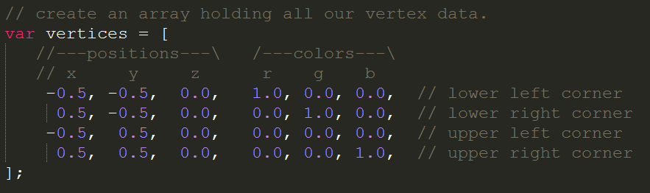
Combining the Color and Position Vertex Buffers
The code simply pastes the rgb values after the xyz values.
How will we feed the Vertex fragment with this data?

Slide 48
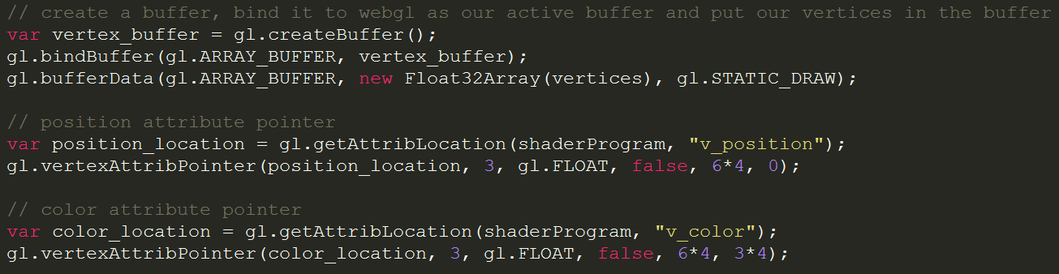
Combining the Color and Position Vertex Buffers
We use 2 pointers as specified in the image before.
There is just one more loose end left.
Notes:
What happens is is not so complex once you know every parameter of vertexAttribPointer.
The 1st parameter is the pointer to the variable in the shader we want to supply data to.
The 2nd parameter specifies how much of an object we want to supply.
The 3rd parameter is the type of object we want to supply.
The 4th parameter is a Boolean indicating if data should be normalized. This only has meaning when you work with binary data, so a false for us.
The 5th parameter specifies the space a single vertex takes in bytes. We have 3 positions and 3 colors so 6 float values. A float in javascript is 32 bits(see Float32Array above) so 4 bytes. This should be 6*8.
The 6th parameter is the offset in bytes at which to start reading data from at the beginning of the array. Colors should skip 3 elements at the start, so 3*4.

Slide 49
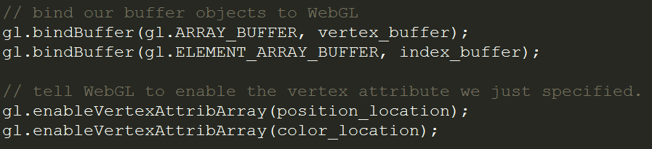
Combining the Color and Position Vertex Buffers
We remove our color buffer and don’t bind it anymore.
The location is still necessary as that is the point in the shader we will feed data to.

Slide 50
Step 3: Transformations and the math
behind them
Part 1: 2D vectors
Disclaimer: I am not a mathematician

Slide 51
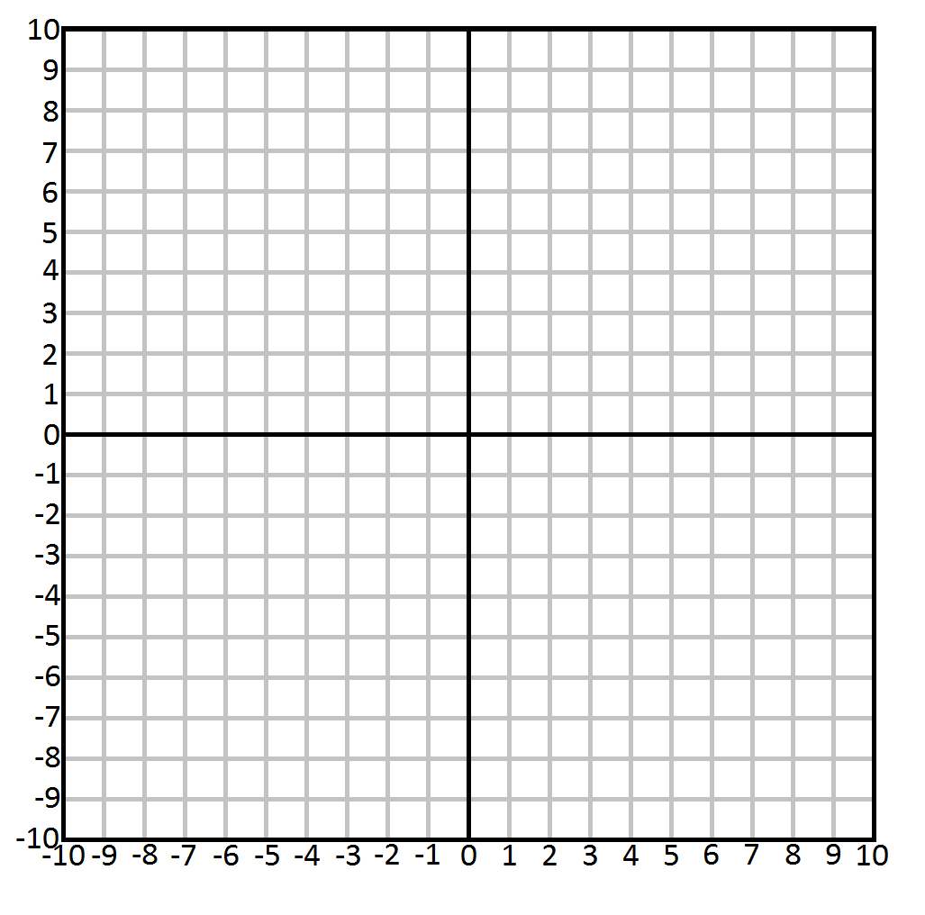
Math part 1: 2D vectors
Let’s start off with 2D examples and slowly work into 3D and transformations.
This is a 2D Cartesian system.
Notes:
The Cartesian space is the space you might remember from drawing graphs in math at school.

Slide 52
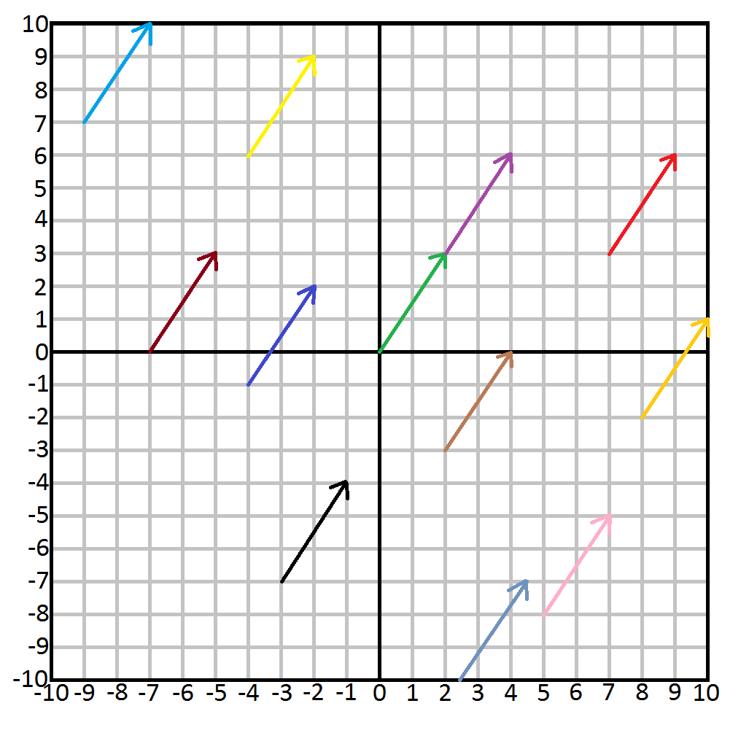
Math part 1: 2D vectors
This is a 2D Cartesian system with vectors.
Which arrow indicates vector (2, 3)?
Notes:
This is pure mathematical, in the actual code we use vectors for many different purposes. Mathematically a vector only indicates direction and magnitude. In this case all the arrows indicate the vector (2, 3) as they all travel 2 positions in the positive x axis, and 3 in the positive y axis. Vector’s are thus not positions, unlike we have been using them so far.

Slide 53
Math part 1: 2D vectors
All of them are the same vector.
A vector in mathematics indicates only 2 things:
Direction
Magnitude
Math part 1: 2D vectors
A vector is usually notated with a bold symbol or a symbol with an arrow on top.
x
y
v = v =
The 2 numbers in a vector are usually displayed on top of each other for convenience
Notes:
As the vector can only indicate Direction and Magnitude, position will mathematically not be indicated with a vector. In programming we do abuse the vector type for this purpose because it fits perfectly.

Slide 54
Math part 1: 2D vectors
Vectors can also be manipulated in many different ways.
Let’s start with scalar operations:
2
5
v * s =
2 * 5
5 * 5
=
10
25
Vector: v = v =
Multiplication:
Scalar: s = 5
v / s =
2 / 5
5 / 5
=
0.4
1
Division:
The scalar will simply be applied to every member of the vector, even with 3D vectors.
Addition and Subtraction with just a scalar are weird:

Slide 55
Math part 1: 2D vectors
Vectors can also be manipulated in many different ways.
Let’s start with scalar operations:
v + s =
2 + 5
5 + 5
=
7
10
Addition:
2
5
v - s =
2 - 5
5 - 5
=
-3
0
Vector: v = v =
Subtraction:
Scalar: s = 5
v * s =
2 * 5
5 * 5
=
10
25
Multiplication:
v / s =
2 / 5
5 / 5
=
0.4
1
Division:
The scalar will simply be applied to every member of the vector, even with 3D vectors.
Why are adding and subtracting scalars a weird thing to do to vectors?

Slide 56
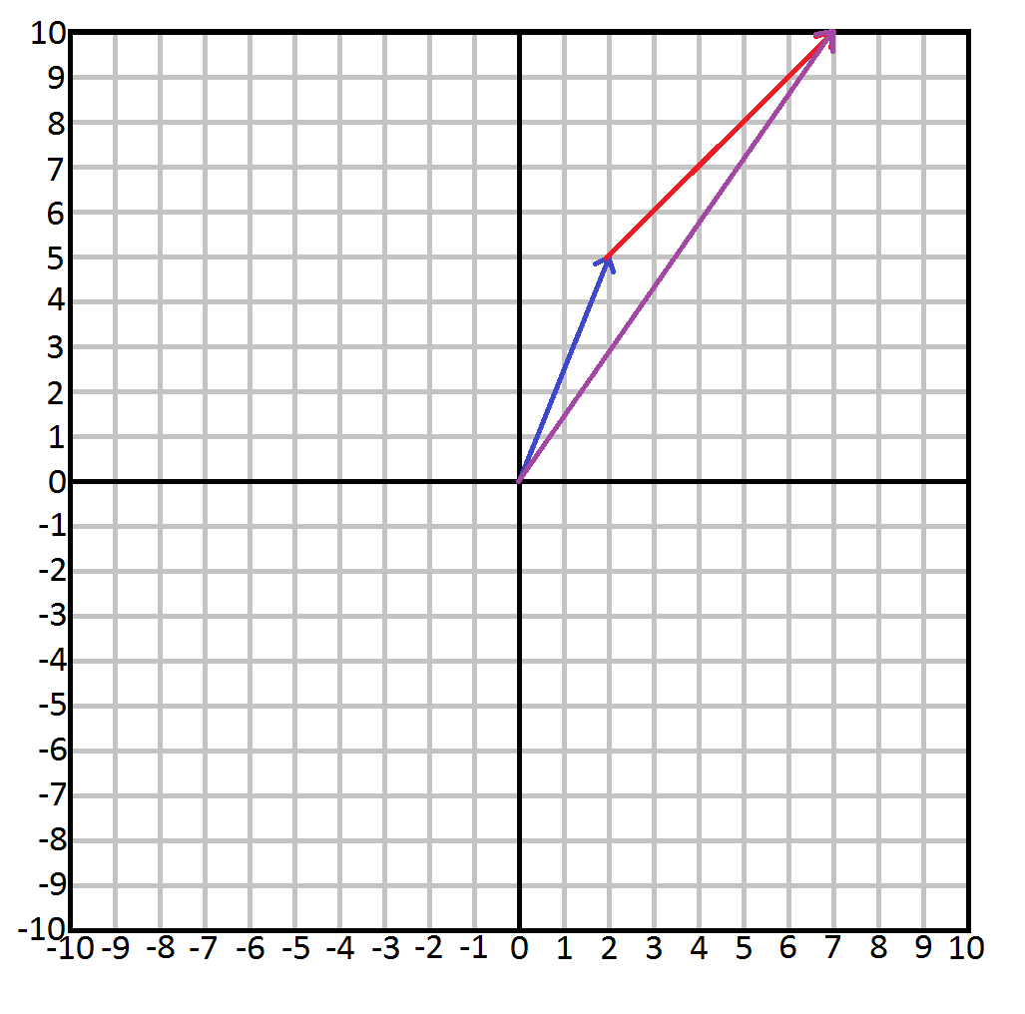
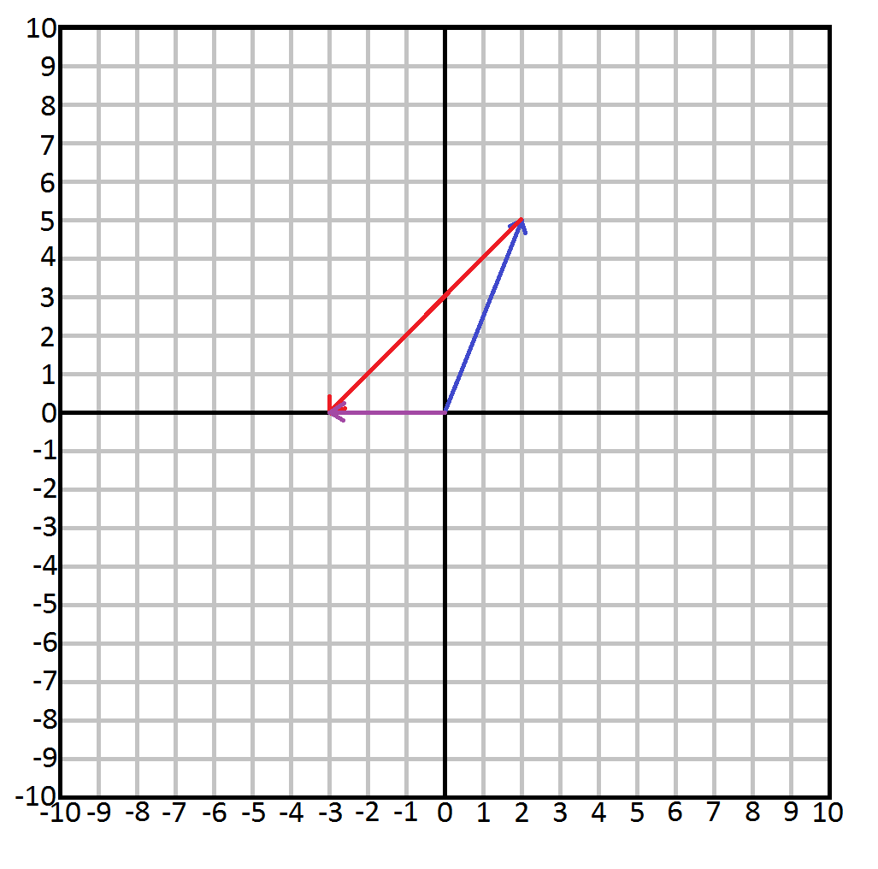
Math part 1: 2D vectors
Addition and subtraction can only move a vector like a bishop in chess.
There is no correlation because both direction and magnitude change in weird ways.
2
5
Vector: v = v =
Scalar: s = 5
v + s =
2 + 5
5 + 5
=
7
10
v - s =
2 - 5
5 - 5
=
-3
0
Addition:
Subtraction:
Multiplying and Dividing by a scalar is much more useful.
Notes:
Adding and subtracting a scalar from a vector is weird because moving like a bishop says nothing about a vector, as vectors do not have positions. The direction and magnitude will change without any correlation to the original vector.

Slide 57
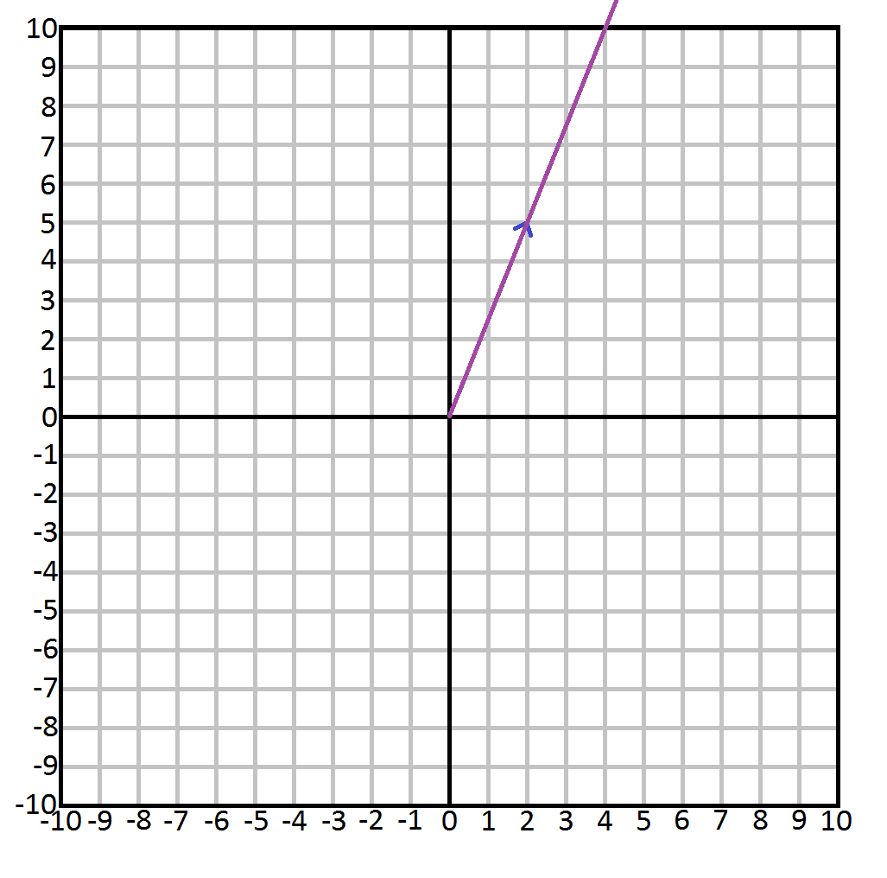
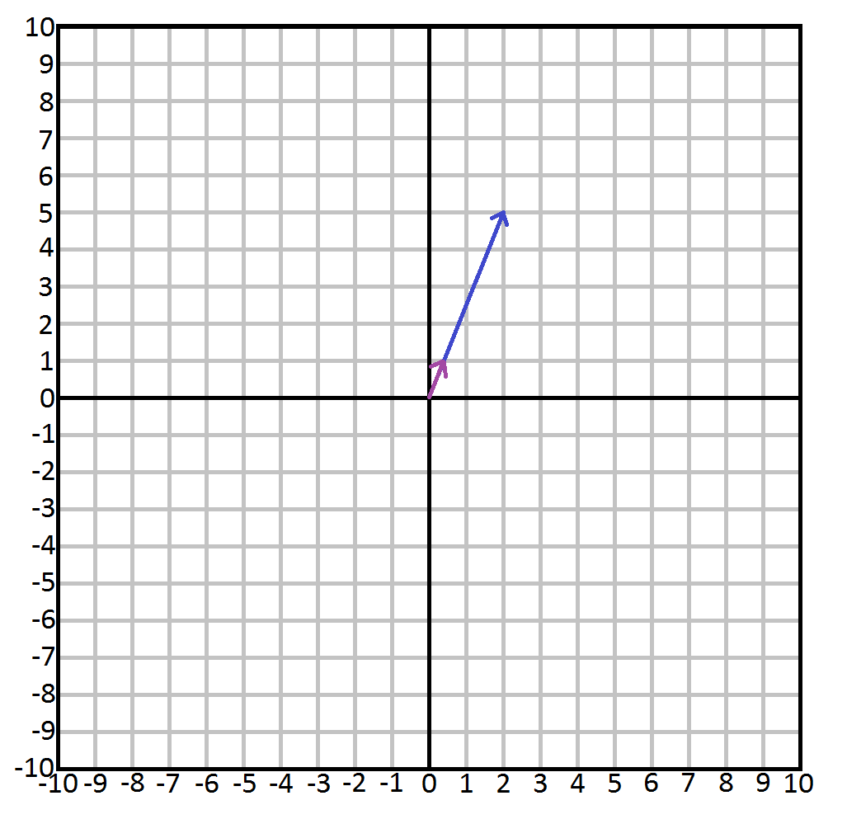
Math part 1: 2D vectors
Multiplication and Division lengthen or shorten the distance of the vector.
The direction will remain, making them very useful.
2
5
Vector: v = v =
Scalar: s = 5
v * s =
2 * 5
5 * 5
=
10
25
v / s =
2 / 5
5 / 5
=
0.4
1
Multiplication:
Division:
Another useful operation is flipping the vector. Any idea how you can do this?

Slide 58
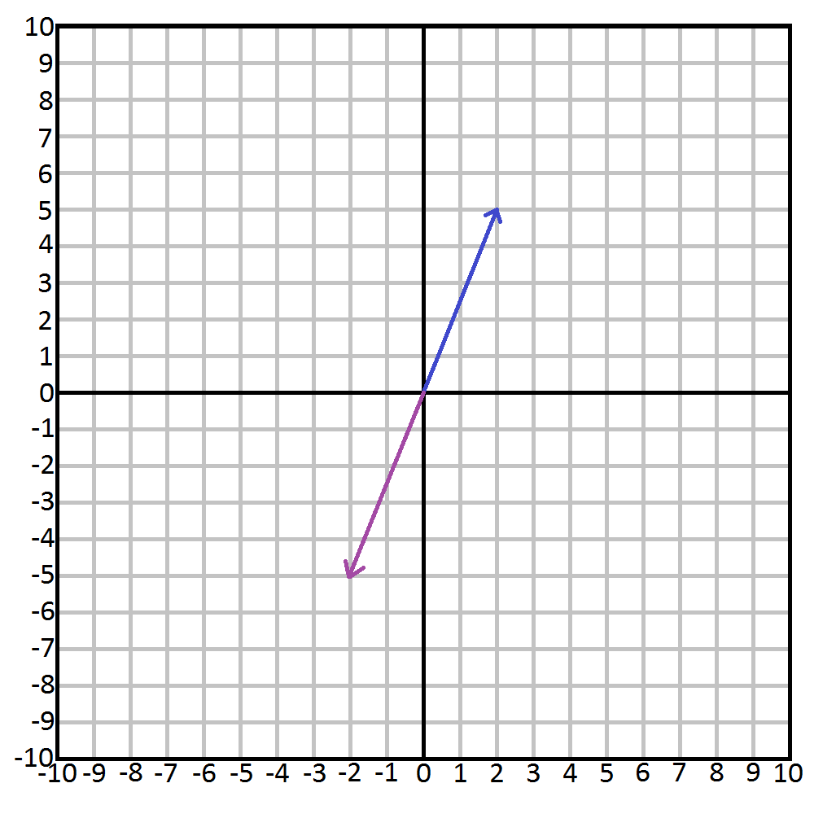
Math part 1: 2D vectors
Flipping a vector is done by simple multiplying the vector with the scalar -1.
2
5
Vector: v = v =
Scalar: s = -1
v * s =
2 * -1
5 * -1
=
-2
-5
Multiplication:
Let’s continue to vector on vector operations.

Slide 59
Math part 1: 2D vectors
Take these 2 vectors:
2
5
3
1
v = v =
w = w =
v + w =
2 + 3
5 + 1
=
5
6
v - w =
2 - 3
5 - 1
=
-1
4
Addition:
Subtraction:
Seeing this visually will make it much clearer.
Notes:
This example shows why it is easier to write the numbers on top of each other. There are many other ways to manipulate vectors, like using a scalar to add/subtract etc, the dot product, the cross product, and many more. See http://higherorderfun.com/blog/2012/06/03/math-for-game-programmers-05-vector-cheat-sheet/ for more information

Slide 60
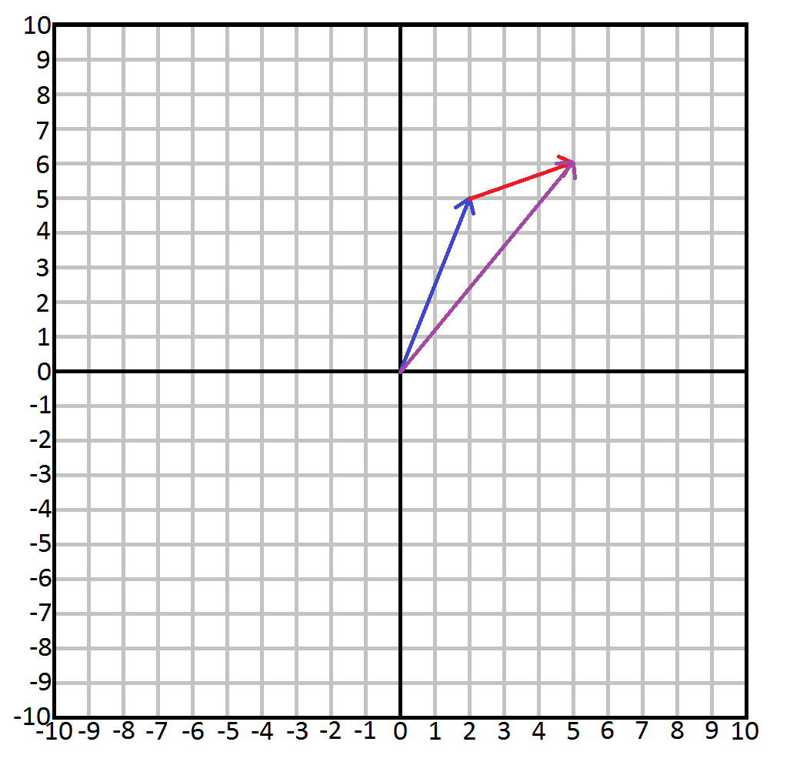
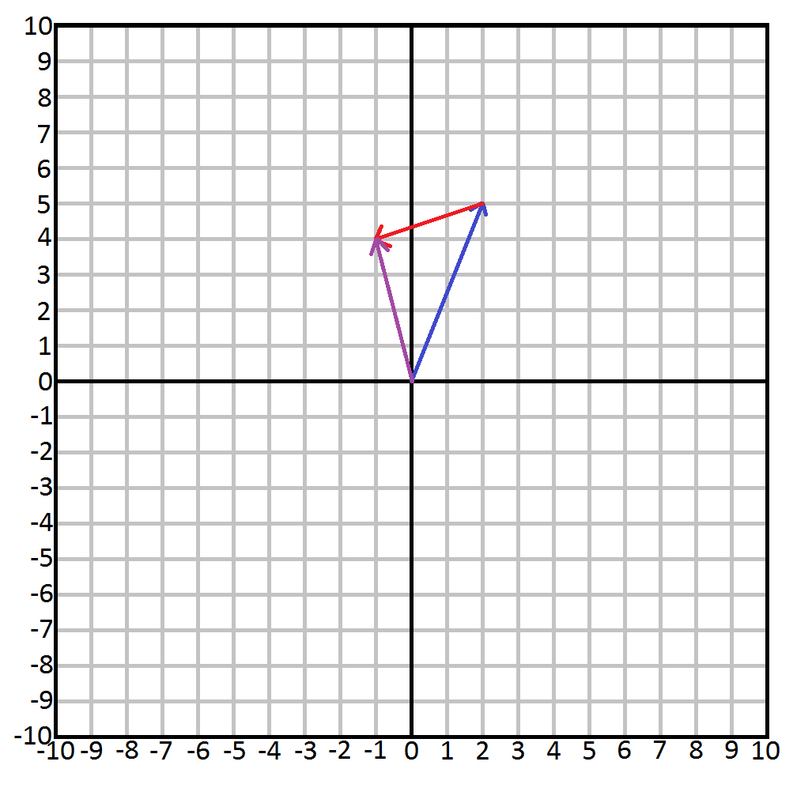
Math part 1: 2D vectors
This is the visual representation of the Addition and Subtraction of our v and w vectors
Addition
Subtraction
Will these vectors have the same outcome regardless of order?
Notes:
Just placing the vectors head to tails will give us the answer for addition and subtraction.

Slide 61
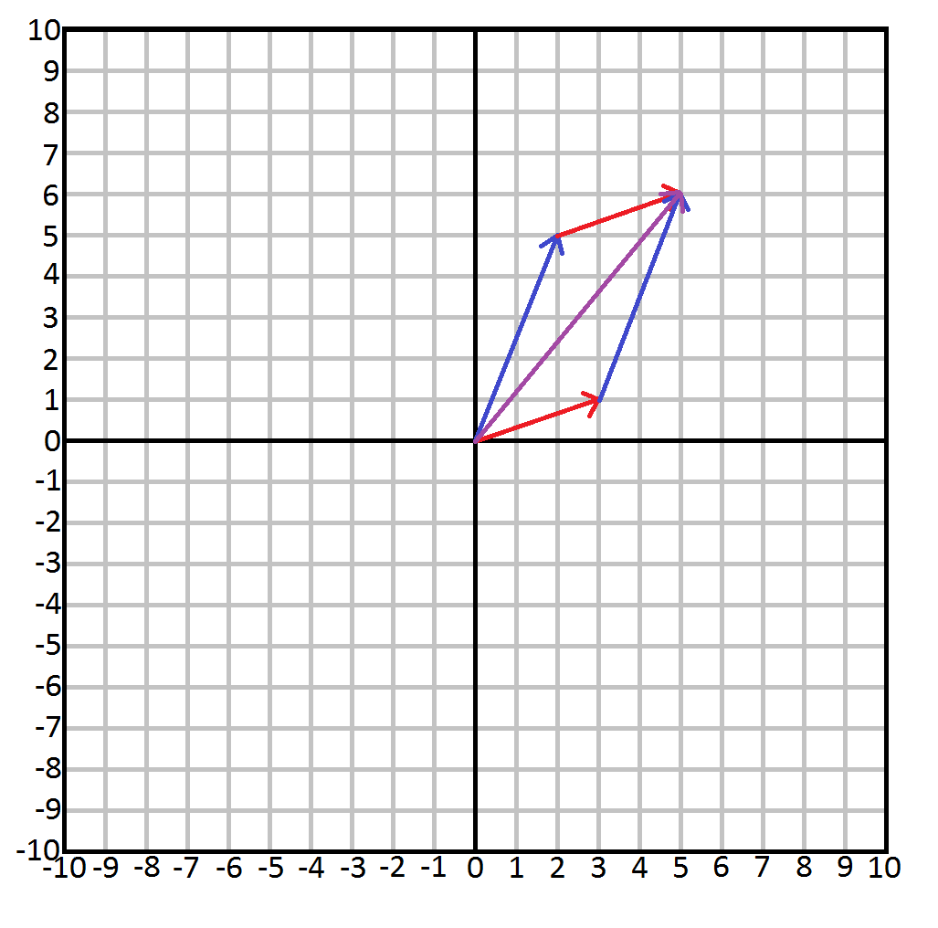
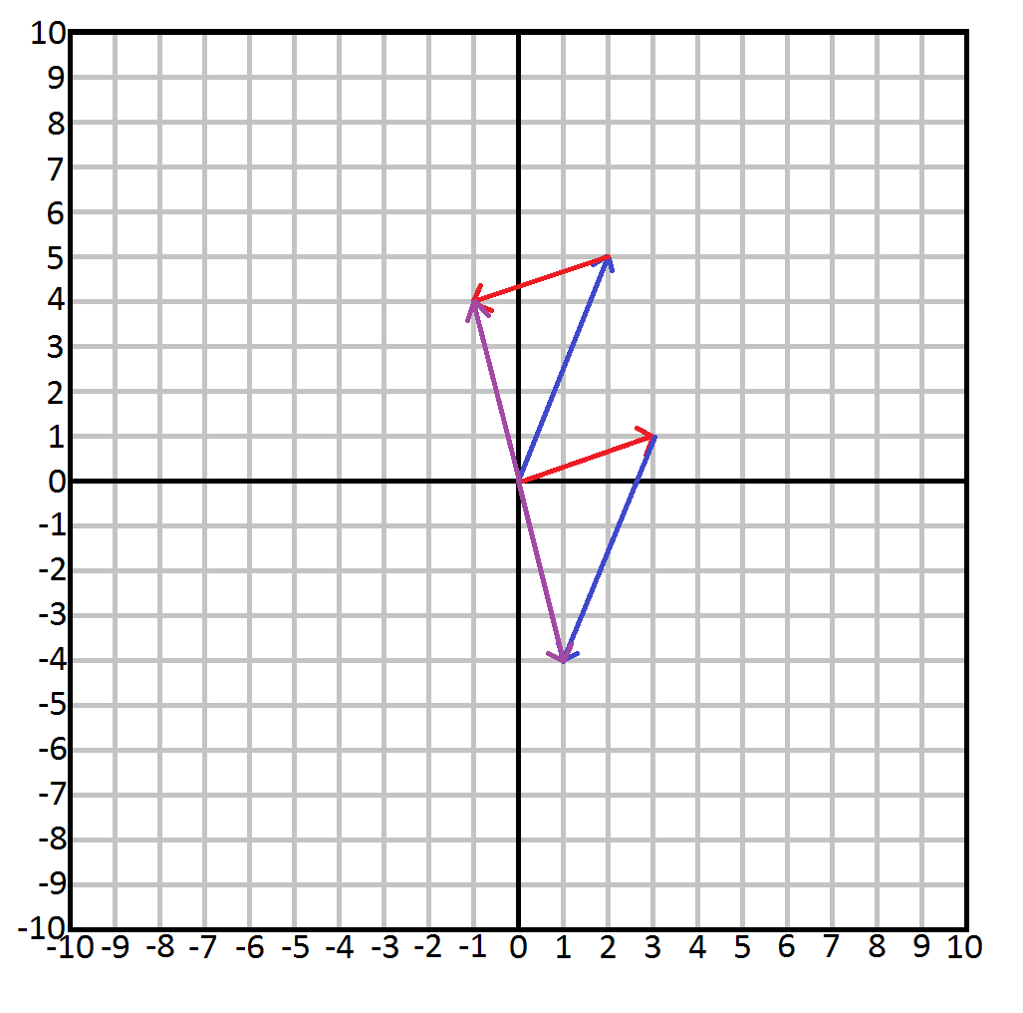
Math part 1: 2D vectors
Addition does, subtraction does not.
Addition
Subtraction
The math will continue at the end of part III

Slide 62
Math part 1: 2D vectors
To be continued next time…
Notes:
The same applies for Multiplication and Division, multiplication will always produce the same result while division will not.

Slide 63
Afsluiting
Thanks for listening.

Slide 65
Part III
Presentation by: Quincy Jacobs
Notes:
Part III will continue math explanations to get to the result in Example 4.
https://github.com/QuincyJacobs/WebGLTutorial

Slide 66
Session preview
This session will focus on these points:
Adding textures
Transformations and the math behind them
Part 2: 2D vectors

Slide 67
Step 1: Adding textures

Slide 68
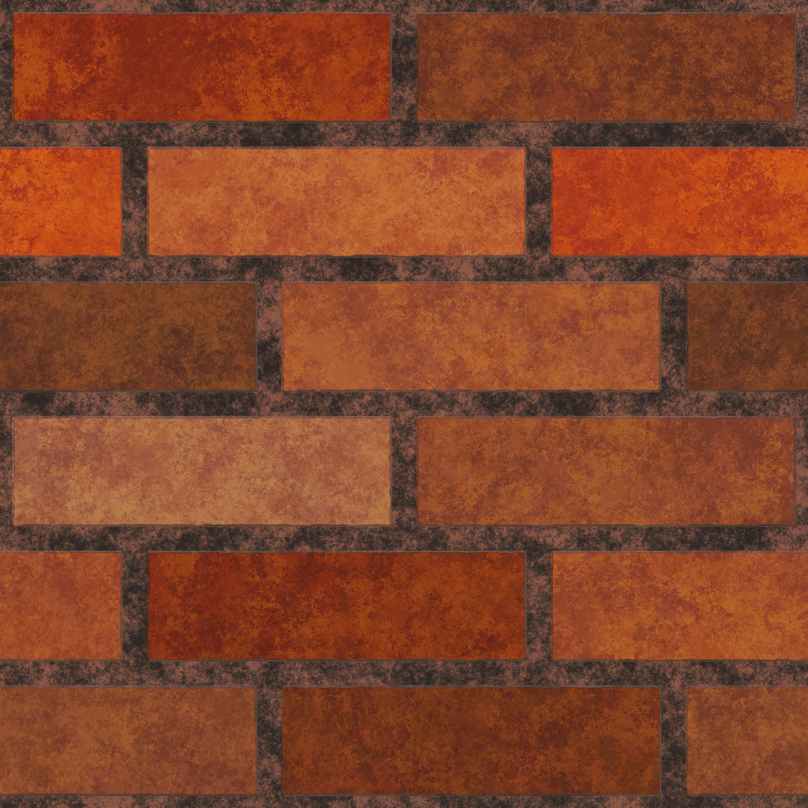
Adding textures
In part 3 we will first add textures to our program before jumping into the math again.
We will render this image over a square.

Slide 69
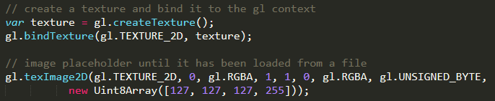
Adding textures
First we have to create a texture and bind it, very similar to our buffers.
Next we will load an image from an external source.
Notes:
For the full parameter list on texImage2D look at the following source: https://developer.mozilla.org/en-US/docs/Web/API/WebGLRenderingContext/texImage2D

Slide 70

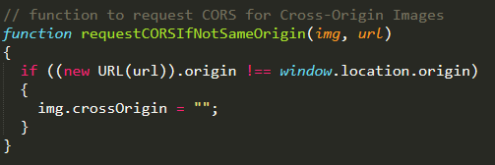
Adding textures
We load the image from an external path.
Loading an image means dealing with Cross-Origin Resource Sharing (CORS)
Next we will set the texture parameters once the image has been loaded
Notes:
Further reading in CORS: https://developer.mozilla.org/en-US/docs/Web/HTTP/CORS

Slide 71
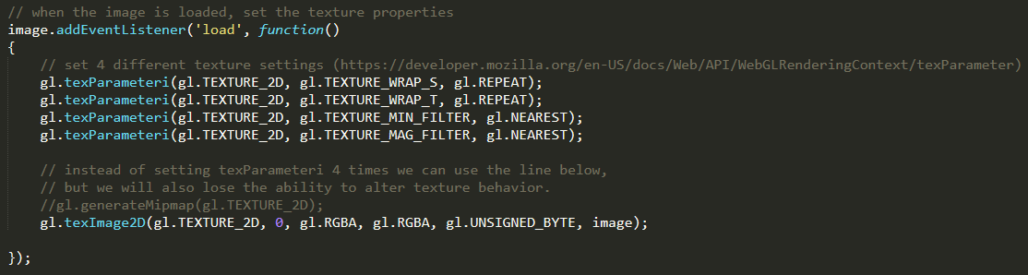
Adding textures
We want to set the texture settings after the image is loaded.
Let’s briefly visit each of these texture parameters
Notes:
Texture settings documentation: https://developer.mozilla.org/en-US/docs/Web/API/WebGLRenderingContext/texParameter

Slide 72
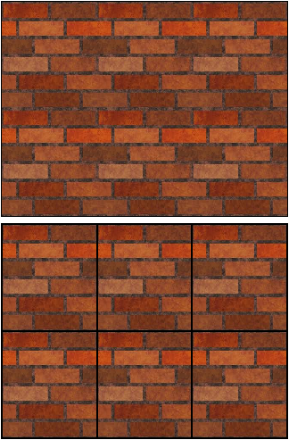
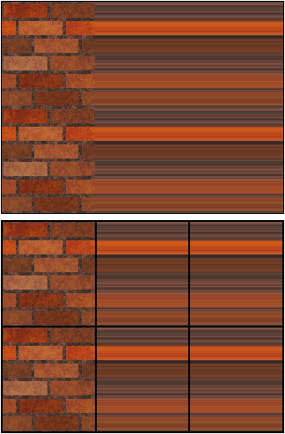
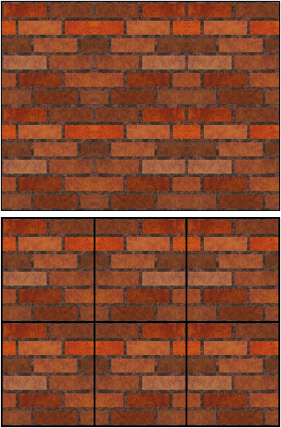
Adding textures
First we set the TEXTURE_WRAP_S parameter.
There are 3 options for this parameter:
gl.REPEAT
gl.CLAMP_TO_EDGE
gl.MIRRORED_REPEAT

Slide 73
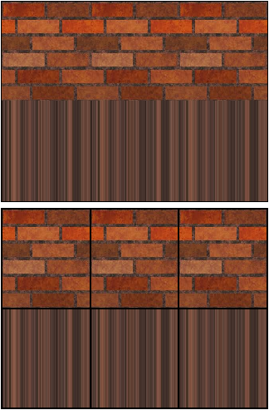
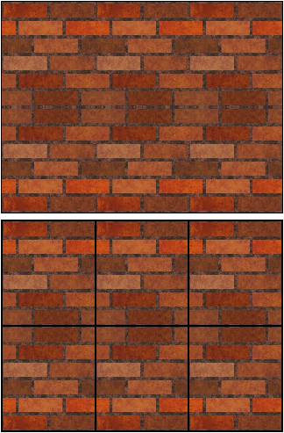
Adding textures
Next we set the TEXTURE_WRAP_T parameter.
The parameters are the same as TEXTURE_WRAP_S, but travel on the y-axis:
gl.REPEAT
gl.CLAMP_TO_EDGE
gl.MIRRORED_REPEAT

Slide 74
Adding textures
Lastly we set the TEXTURE_MIN_FILTER and TEXTURE_MAG_FILTER parameters.
These options have more delicate differences, so here are the options without image:
GL_NEAREST - (no filtering, no mipmaps)
GL_LINEAR - (filtering, no mipmaps)
GL_NEAREST_MIPMAP_NEAREST - (no filtering, sharp switching between mipmaps)
GL_NEAREST_MIPMAP_LINEAR - (no filtering, smooth transition between mipmaps)
GL_LINEAR_MIPMAP_NEAREST - (filtering, sharp switching between mipmaps)
GL_LINEAR_MIPMAP_LINEAR - (filtering, smooth transition between mipmaps)
Notes:
For more info on this parameter, see the OpenGL Programming Guide: http://www.glprogramming.com/red/chapter09.html#name3

Slide 75
Adding textures
Now we have everything we need to load the image.
We need a few more things to actually show the image on our object:
Texture logic in Shaders
Texture Vertex Buffer Object
Loading in a texture
Let’s start with the shaders

Slide 76
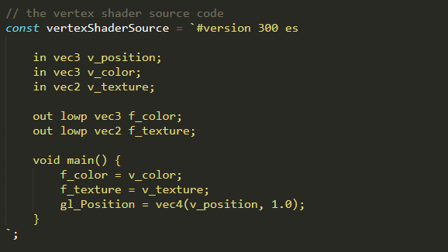
Adding textures
We will abuse the vertex shader as a conduit, just like we did with colors.
Do note that in contrast to color, texture is a vec2.
Notes:
Explanation about the vec2 is to come later.

Slide 77
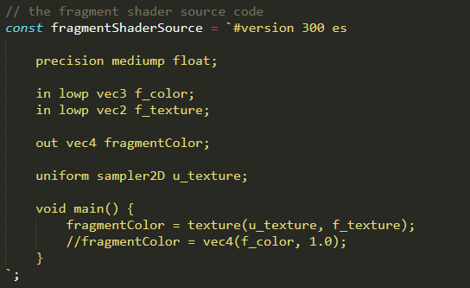
Adding textures
In the fragment shader we will use the texture instead of the color.
Let’s briefly go through what happens here.

Slide 78
Adding textures
Receiving the texture coordinate values from the vertex shader should be nothing new.
Now we declare a uniform where we input the actual image of the texture.
Finally we let webgl do the work using the texture and the texture coordinates.
This finishes up the shaders, we will now move on to the Vertex Buffer Object.

Slide 79
Adding textures
First we have to add vertice data for our texture coordinates.
Let’s grab the images from a few slides back to understand how these coordinates work.
The actual texture
How it will be implemented

Slide 80
Adding textures
The first step is to look at how the fragment shader will interpret the data.
This is how a single texture file is seen in coordinates:
0.0 : 0.0
1.0 : 0.0
0.0 : 1.0
1.0 : 1.0

Slide 81
Adding textures
In the example I have implemented my wall a few times over only 4 points.
Can you guess what the “texture coordinate” values should be?
0.0 : 0.0
3.0 : 0.0
0.0 : 2.0
3.0 : 2.0

Slide 82
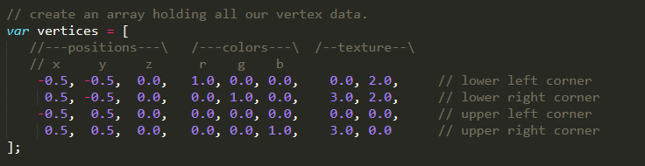
Adding textures
Now let’s implement those points into our vertice data.
Notice how easy they are to implement in our vertex data.

Slide 83
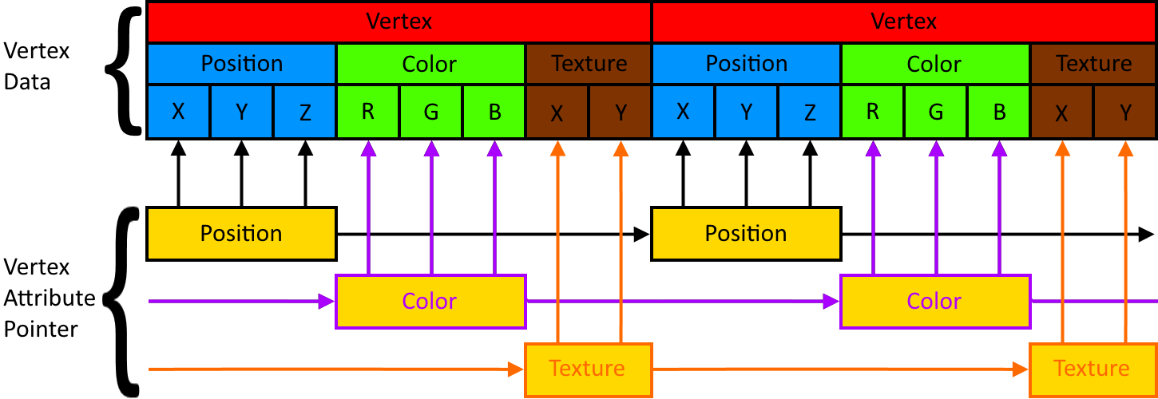
Adding textures
The next step is to create a vertex attribute pointer for textures.
Textures will be added to the mix just like colors did.

Slide 84
Adding textures
With the last slide in mind, how will we implement the texture Vertex Attribute Pointer?
This was the state before textures:
Note: We called the shader input “v_texture”
Notes:
// 1st arg: pointer to the position where the vertex data can be inserted
// 2nd arg: number of components per vertex attribute
// 3rd arg: what type of data each vertex attribute will be
// 4th arg: normalization, this has no effect on floats, but will cast other types into their usual values
// 5th arg: specifies the offset in bytes between vertex attributes. In this case 8*4 because we have 8
// values per element (x,y,z,r,g,b,tx1,tx2) times 4 bytes (32 bit floats).
// 6th arg: offset, specifies at which position (in bytes) in the vertex array the first element starts.

Slide 85
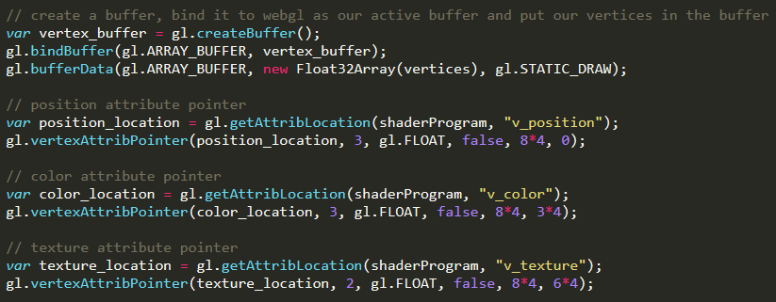
Adding textures
The state of Vertex Attribute Pointers with textures added will be:
Notice how we have 8*4 now because we have 8 elements in our vertex array (and a float is 4 byte in javascript)
Notes:
// 1st arg: pointer to the position where the vertex data can be inserted
// 2nd arg: number of components per vertex attribute
// 3rd arg: what type of data each vertex attribute will be
// 4th arg: normalization, this has no effect on floats, but will cast other types into their usual values
// 5th arg: specifies the offset in bytes between vertex attributes. In this case 8*4 because we have 8
// values per element (x,y,z,r,g,b,tx1,tx2) times 4 bytes (32 bit floats).
// 6th arg: offset, specifies at which position (in bytes) in the vertex array the first element starts.

Slide 86

Adding textures
Don’t forget to enable the Vertex Attribute Array
Now there are just a few things left to use our loaded texture.

Slide 87
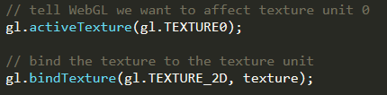
Adding textures
First we activate a texture unit to store our texture in.
Then we bind our loaded in texture to the activated texture unit.
The sampler2D in the fragment shader takes a bound texture unit, and defaults to gl.TEXTURE0 in this case.
Notes:
See this url for more textures: https://webglfundamentals.org/webgl/lessons/webgl-2-textures.html

Slide 88
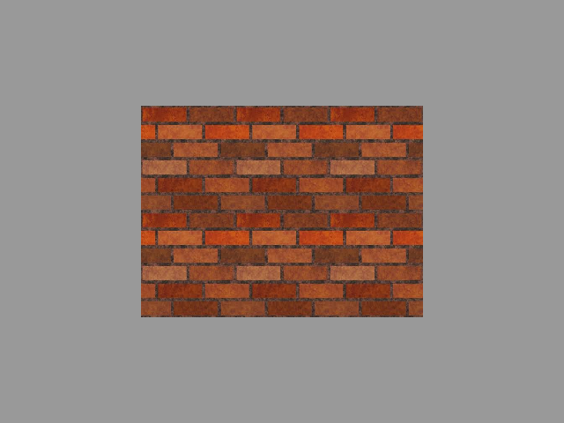
Adding textures
Here is the result of our hard work:
Now let’s jump back into the math.

Slide 89
Step 2: Transformations and the math
behind them
Part 2: 2D/3D vectors
Disclaimer: I am still not a mathematician

Slide 90
Math part 2: 2D/3D vectors
Last time we discussed adding and subtracting vectors.
2
5
3
1
v = v =
w = w =
v + w =
2 + 3
5 + 1
=
5
6
v - w =
2 - 3
5 - 1
=
-1
4
Addition:
Subtraction:
Now let’s do these calculations with 3D vectors.
Notes:
This example shows why it is easier to write the numbers on top of each other. There are many other ways to manipulate vectors, like using a scalar to add/subtract etc, the dot product, the cross product, and many more. See http://higherorderfun.com/blog/2012/06/03/math-for-game-programmers-05-vector-cheat-sheet/ for more information

Slide 91
Math part 2: 2D/3D vectors
Switching over to 3D vectors.
2
5
4
3
1
2
v = v =
w = w =
2 + 3
5 + 1
4 + 2
5
6
6
2 - 3
5 - 1
4 - 2
-1
4
2
v + w =
=
Subtraction:
v - w =
=
Addition:
We will get to the “multiplying” of vectors soon, but before that we have 2 other subjects.
Notes:
This example shows why it is easier to write the numbers on top of each other. There are many other ways to manipulate vectors, like using a scalar to add/subtract etc, the dot product, the cross product, and many more. See http://higherorderfun.com/blog/2012/06/03/math-for-game-programmers-05-vector-cheat-sheet/ for more information

Slide 92
Math part 2: 2D/3D vectors
The length (or magnitude) of a vector is how far the vector travels in any direction.
|v|
The length of a vector is denoted as a character between 2 (or 4) vertical lines:
The length of a vector is always an absolute value, meaning it can not be negative.
The length of a vector is calculated using this formula:
|v| = √(vx) + (vy)
2
2
Notes:
Length and magnitude are interchangeable terms when talking about vectors.

Slide 93
Math part 2: 2D/3D vectors
The length (or magnitude) of a vector is calculated using this formula:
|v| = √(vx) + (vy)
2
2
This formula is called Pythagoras’ theorem:
c = a + b
2
2
2
For our vector V the length should be:
3
4
v = v =
|v| = √(3) + (4) = 5
2
2
Notes:
Length and magnitude are interchangeable terms when talking about vectors.

Slide 94
Math part 2: 2D/3D vectors
The length (or magnitude) of a 3D vector is calculated using this formula:
|v| = √(vx) + (vy) + (vy)
2
2
2
Pythagoras’ theorem still holds in 3D:
d = a + b + c
2
2
2
2
For our vector V the length should be:
3
4
5
v = v =
|v| = √(3) + (4) + (5) ≈ 7.07
2
2
2
Notes:
Length and magnitude are interchangeable terms when talking about vectors.

Slide 95
Math part 2: 2D/3D vectors
A unit vector is a vector where the length of the vector equals 1.
v
A unit vector is denoted as a character with a roof over it’s head:
Unit vectors are really useful for calculations that use the length of a vector, as it will be 1.
A unit vector is calculated using this formula:
v = v / |v|
Calculating the unit vector is called normalizing a vector.
Notes:
Calculations that use Unit Vectors are often calculations that are only about direction (like facing a certain way). The actual size of the original vector does not matter in these cases.

Slide 96
Math part 2: 2D/3D vectors
A unit vector is calculated by dividing each component of the original vector by the vector’s length. So:
3
4
v = v =
Vector
|v| = √(3) + (4) = 5
2
2
Length / Magnitude
3 / 5
4 / 5
0.6
0.8
v = v / |v| = =
Unit vector
And the proof that the length (or magnitude) of this vector equals 1:
|v| = √(0.6) + (0.8) = √(0.36 + 0.64) = √1 = 1
2
2
Notes:
Calculations that use Unit Vectors are often calculations that are only about direction (like facing a certain way). The actual size of the original vector does not matter in these cases.

Slide 97
Math part 2: 2D/3D vectors
A unit vector will behave the same in 3D, just adding a 3rd number to the equation.
3
4
5
v = v =
Vector
|v| = √(3) + (4) + (5) ≈ 7.07
2
2
2
2
2
Length / Magnitude
3 / 7.07
4 / 7.07
5 / 7.07
0.424
0.566
0.707
v = v / |v| = ≈
Unit vector
And the proof that the length (or magnitude) of this vector equals 1:
2
2
|v|= √(0.424) + (0.566) + (0.707) = √(0.18 + 0.32 + 0.50) = √1 = 1
2
Notes:
Calculations that use Unit Vectors are often calculations that are only about direction (like facing a certain way). The actual size of the original vector does not matter in these cases.

Slide 98
Math part 2: 2D/3D vectors
“Multiplying” a vector can be done using 2 methods.
Dot product
Cross product
a · b = |a|·|b|· cosθ
ax
ay
az
bx
by
bz
ay · bz - az · by
az · bx - ax · bz
ax · by - ay · bx
cx
cy
cz
or
a × b =
×
=
=
a · b = ax · bx + ay · by + az · bz
or
a × b = |a|·|b|· sinθ · n
We will shortly go through both, and then finally get to the transformation/scaling and rotation matrices.
Notes:
The “dot product” may sometimes also be called the “scalar product" or “inner product”.
The “cross product” may sometimes also be called the “outer product”.
Theta = θ = plane angle
n = the unit vector

Slide 99
Math part 2: 2D/3D vectors
The dot product actually has 2 ways to calculate it:
a · b = |a|×|b|× cosθ
a · b = ax × bx + ay × by
The dot product will always result in a scalar.
The dot product is very useful when determining vectors’ angle and direction.
When the vectors face the same direction, the outcome will be positive.
When the vectors are at a right angle (90 degrees), the outcome will be 0.
When the vectors are facing the opposite direction, the outcome will be negative.
Notes:
cos⁻¹((a · b) / (|a|×|b|)) = θ

Slide 100
Math part 2: 2D/3D vectors
Let’s try to calculate the dot product.
3
4
5
6
2
1
v = v =
a = a =
Vector
|v| = √(3) + (4) + (5) ≈ 7.07
2
2
2
2
2
Length / Magnitude
|a| = √(6) + (2) + (1) ≈ 6.4
2
2
2
2
2
3 / 7.07
4 / 7.07
5 / 7.07
0.424
0.566
0.707
v = v / |v| = ≈
Unit vector
6 / 6.4
2 / 6.4
1 / 6.4
0.938
0.313
0.156
a = a / |a| = ≈

Slide 101
Math part 2: 2D/3D vectors
Let’s try to calculate the dot product.
a · b = ax · bx + ay · by + az · bz
Method 1
1.
a · b = 3 · 6 + 4 · 2 + 5 · 1
2.
a · b = 18 + 8 + 5
3.
a · b = 31
Notes:
To calculate the angle, just apply the formula with the unit vector and cos⁻¹ the result!

Slide 102
Math part 2: 2D/3D vectors
Let’s try to calculate the dot product.
a · b = |a|·|b|· cosθ
Method 2
1.
31 = √50 · √41 · cosθ
2.
cosθ = 31 / (√50 · √41)
3.
cosθ ≈ 0.6847….
4.
θ = cos⁻¹ (0.6847….) = 46.79
5.
√50 · √41 · cos(46.79) = 31
Notes:
We know that the dot product of vector a and b is 31 from the previous example.
This method is hard because the angle (θ) has to be known as well.

Slide 103
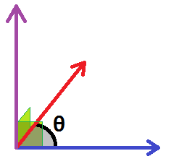
Math part 2: 2D/3D vectors
The cross product also has 2 ways to calculate it, but we will only discuss this one:
ax
ay
az
bx
by
bz
ay · bz - az · by
az · bx - ax · bz
ax · by - ay · bx
cx
cy
cz
a × b =
×
=
=
The cross product will result in a vector that’s at the ‘right’ (90 degrees) angle to both vectors.
c
a × b = c
b
a
Notes:
cos⁻¹((a · b) / (|a|×|b|)) = θ

Slide 104
Math part 2: 2D/3D vectors
Let’s try to calculate the cross product.
ax
ay
az
bx
by
bz
ay · bz - az · by
az · bx - ax · bz
ax · by - ay · bx
cx
cy
cz
a × b =
×
=
=
3
4
5
6
2
1
4 · 1 - 5 · 2
5 · 6 - 3 · 1
3 · 2 - 4 · 6
-6
27
-18
a × b =
×
=
=
Notes:
To calculate the angle, just apply the formula with the unit vector and cos⁻¹ the result!

Slide 105
Math part 2: 2D/3D vectors
TO DO:
Dot product finish-up
Cross product
Matrixes
Identity matrix
Translation matrix
Scale matrix
Rotation matrix

